Slide 1
INVESTIGATION OF HUMAN TRAVEL AND ACTIVITY PATTERNS BY LEVERAGING
FOURSQUARE LOCATION-BASED SOCIAL NETWORK DATA
Coursera Capstone Project
Student: Florian Cartuta

Slide 2
INTRODUCTION
Researchers are interested to understand human activity patterns and travel behaviors.
Conventionally, such information was in format of travel diaries, but the data is not highly available
and difficult to gather by such methods. Also information about users gender, age, are available on
Foursquare and can be correlated with the traffic and activity patterns in order to further understand
gender differences in travel and activity which is a popular research topic. Diaries are used to record
human daily movements, places visited, activities, time of day, duration of time spent at each place
(venue). A diary is “a record of information in relation to the passage of time”
Information on the movement of people in the city can be used for: urban planning, location
management, transportation management, etc thus being of interest also for local authorities and
companies.

Slide 3
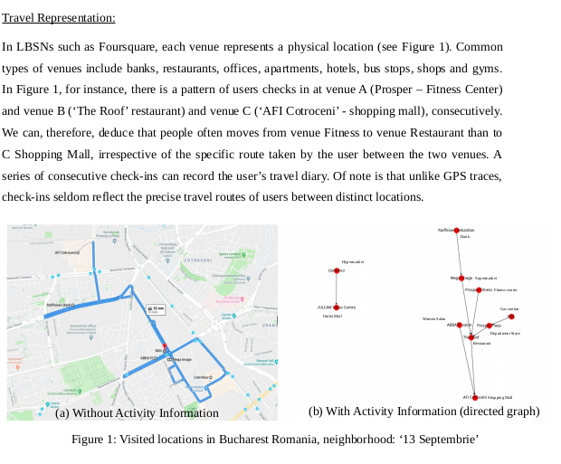

Slide 4
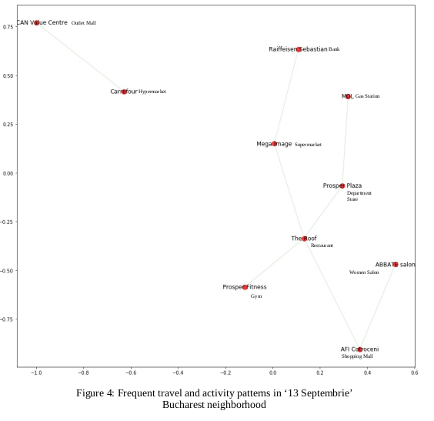
Results
- Looking at the directed graph in figure 4, it is observed that the most often activities in the
neighborhood were visits to the bank, shopping centers, hair styling saloons and fitness centers.
- It also can be observed that there were not identified frequent check-ins into public transportation
facilities which is consistent with the fact that this neighborhood is not covered by the Bucharest
metro line.
- Also there are no frequent check-ins to other type of cultural venue categories like museums, theaters, etc which shows another attribute of this neighborhood which lacks such important cultural venues.

Slide 5
Conclusions
The empirical results reveal that main travel and activity patterns of active local users in ‘13 Septembrie’
neighborhood focuses around shopping, banking and restaurants but there is a lack of important socio-cultural venues like: theaters, museums, etc.
Also it emphasizes the lack of metro line coverage in this neighborhood.
These findings can be taken into consideration by the local authorities to improve the urban planning.

Slide 6
Next steps
This project only uncovers a small part of what can be done using machine learning and LBSN data.
There are interesting opportunities which can be followed as next step, for example to explore how gender influences travel and activity patterns.
There are many directions which can be followed using this methodology and the full extent of the LBSN data.

